Slide 1
Move your characters
Artem, Haneul
Date: 19.09.2025

Slide 2
Haneul

Slide 3
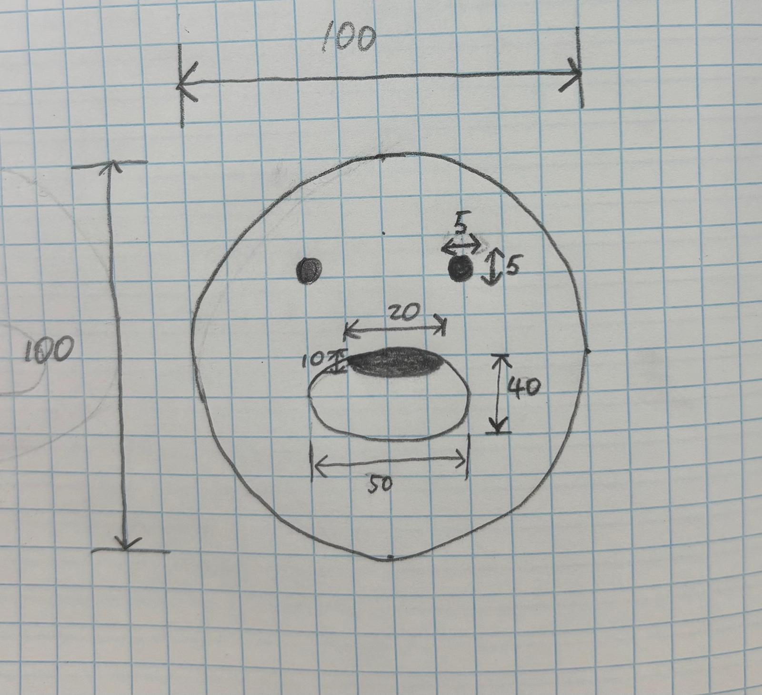
My character (Haneul’s pet)
Face: circle, diameter ≈ 100 px, color = orange.
Muzzle: ellipse, 50×40 px, color = light orange.
Nose: ellipse, 20×10 px, color = black.
Eyes: circles, diameter ≈ 10 px, color = black.

Slide 4
Implemented with processing.
void pet(float x, float y, float d) {
fill(255, 160, 60);
circle(x, y, d*10); // face
ellipse(x, y+d, d*5, d*4); // muzzle
fill(0, 0, 0);
ellipse(x, y-0.5*d, d*2, d); // nose
circle(x+d*2, y-d*2, 0.5*d); // right eye
circle(x-d*2, y-d*2, 0.5*d); // left eye
}

Slide 5
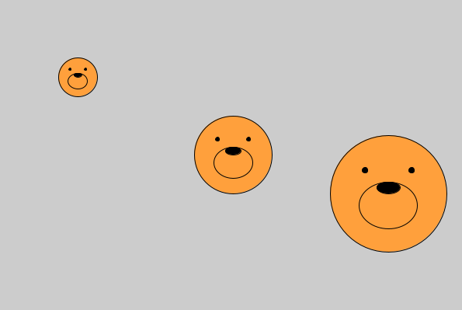
Create a function using the variables (x, y, d).
void setup() {
size(600, 400);
// three calls of the function pet with different x, y, d
pet(100, 100, 5); // small
pet(300, 200, 10); // medium
pet(500, 250, 15); // large
}
void pet(float x, float y, float d) {
fill(255, 160, 60);
circle(x, y, d*10); // face
ellipse(x, y+d, d*5, d*4); // muzzle
fill(0);
ellipse(x, y-0.5*d, d*2, d); // nose
circle(x+d*2, y-d*2, 0.5*d); // right eye
circle(x-d*2, y-d*2, 0.5*d); // left eye
}

Slide 6
Artem

Slide 7
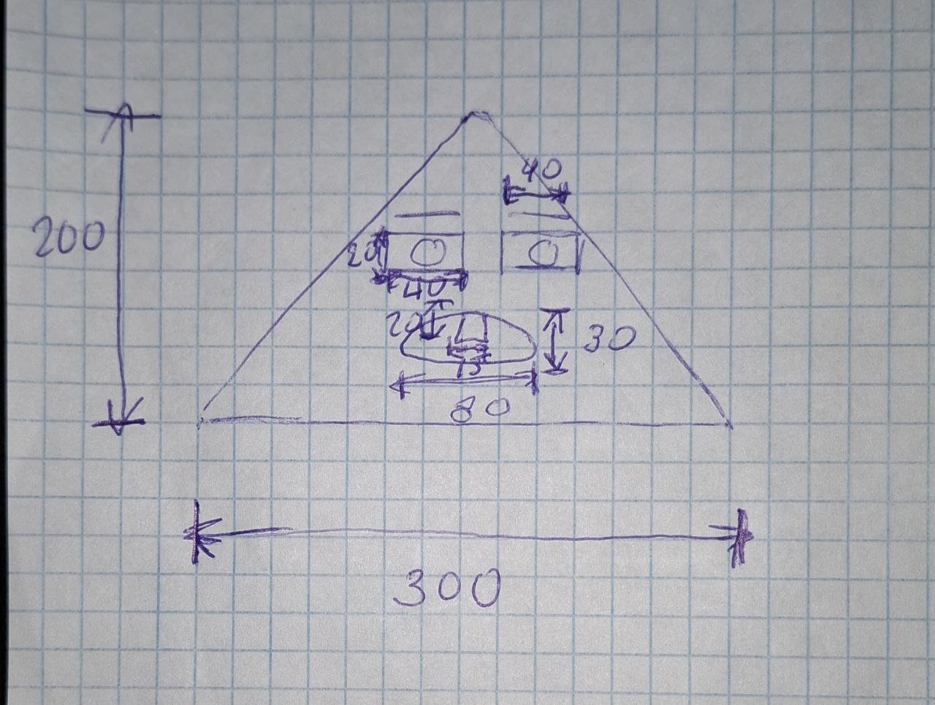
My character (Artem)
Body: triangle, width ≈ 300 px, height ≈ 200 px, color = skin tone
Eyes: rectangles, size ≈ 40×20 px, color = white.
Eyebrows: lines, length ≈ 40 px, color = black.
Pupils: circles, diameter ≈ 15 px, color = blue.
Mouth: ellipse, width ≈ 80 px, height ≈ 30 px, color = white.
Tooth: rectangle, size ≈ 15×20 px, color = light gray.

Slide 8
Implemented with processing.
void artem(float x, float y, float d) {
fill(255, 220, 180);
strokeWeight(2);
// body (triangle)
triangle(x - 15*d, y + 20*d, x + 15*d, y + 20*d, x, y);
// eyes (rectangles)
fill(255);
rect(x - 5*d, y + 9*d, 4*d, 2*d);
rect(x + 1*d, y + 9*d, 4*d, 2*d);
// eyebrows (lines)
stroke(0);
line(x + 1*d, y + 8*d, x + 5*d, y + 8*d);
line(x - 5*d, y + 8*d, x - 1*d, y + 8*d);
// pupils
fill(40, 150, 180);
circle(x - 2.7*d, y + 10*d, 1.4*d);
circle(x + 3.4*d, y + 10*d, 1.6*d);
// mouth
fill(255);
ellipse(x, y + 16*d, 8*d, 3*d);
// tooth
fill(240);
rect(x - 0.5*d, y + 14.6*d, 1.5*d, 2*d);
}

Slide 9
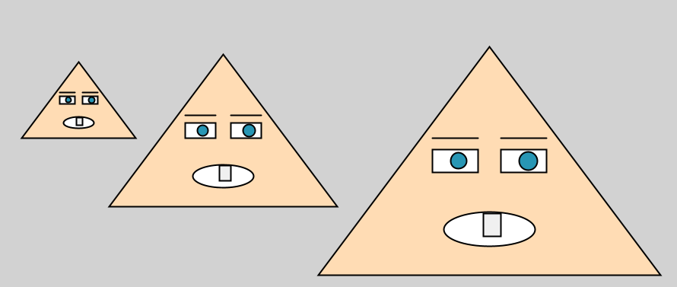
Create a function using the variables (x, y, d).
void setup() {
size(1100, 400); background(210);
artem(110, 90, 5); // small (left)
artem(300, 80, 10); // medium
artem(650, 70, 15); // large
}
void artem(float x, float y, float d) {
fill(255, 220, 180);
strokeWeight(2);
// body
triangle(x - 15*d, y + 20*d, x + 15*d, y + 20*d, x, y);
// eyes
fill(255);
rect(x - 5*d, y + 9*d, 4*d, 2*d);
rect(x + 1*d, y + 9*d, 4*d, 2*d);
// eyebrows
stroke(0);
line(x + 1*d, y + 8*d, x + 5*d, y + 8*d);
line(x - 5*d, y + 8*d, x - 1*d, y + 8*d);
// pupils
fill(40, 150, 180);
circle(x - 2.7*d, y + 10*d, 1.4*d);
circle(x + 3.4*d, y + 10*d, 1.6*d);
// mouth
fill(255);
ellipse(x, y + 16*d, 8*d, 3*d);
// tooth
fill(240);
rect(x - 0.5*d, y + 14.6*d, 1.5*d, 2*d);
}

Slide 10
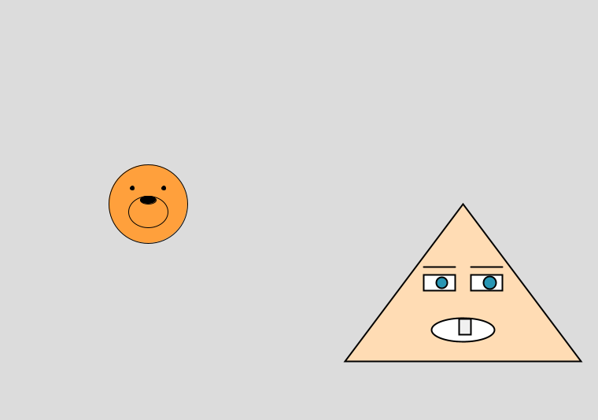
Both
void setup() {
size(800, 600);
background(220);
// Haneul’s pet (слева)
pet(200, 300, 10);
// Artem’s character (справа)
artem(600, 300, 10);
}
void pet(float x,float y, float d){
fill(255,160,60);
circle(x,y,d*10); // face
ellipse(x,y+d,d*5,d*4); // muzzle
fill(0);
ellipse(x,y-0.5*d,d*2,d); // nose
circle(x+d*2,y-d*2,0.5*d); // right eye
circle(x-d*2,y-d*2,0.5*d); // left eye
}
void artem(float x, float y, float d){
fill(255,220,180);
strokeWeight(2);
triangle(x-15*d,y+20*d, x+15*d,y+20*d, x,y); // body
fill(255);
rect(x-5*d,y+9*d,4*d,2*d); // left eye
rect(x+1*d,y+9*d,4*d,2*d); // right eye
stroke(0);
line(x+1*d,y+8*d,x+5*d,y+8*d); // eyebrow right
line(x-5*d,y+8*d,x-1*d,y+8*d); // eyebrow left
fill(40,150,180);
circle(x-2.7*d,y+10*d,1.4*d); // pupil left
circle(x+3.4*d,y+10*d,1.6*d); // pupil right
fill(255);
ellipse(x,y+16*d,8*d,3*d); // mouth
fill(240);
rect(x-0.5*d,y+14.6*d,1.5*d,2*d); // tooth
}

Slide 11
Make it move with all characters.
// positions, sizes and speeds
float x1,y1,d1,vx1,vy1;
float x2,y2,d2,vx2,vy2;
void setup() {
size(1000, 800);
// Artem
x1 = 350; y1 = 300; d1 = 10;
vx1 = 2; vy1 = 3;
// Pet
x2 = 100; y2 = 100; d2 = 10;
vx2 = 3; vy2 = 4;
}
void artem(float x, float y, float d) {
fill(255, 220, 180);
strokeWeight(2);
// body
triangle(x-15*d, y+20*d, x+15*d, y+20*d, x, y);
// eyes
fill(255);
rect(x-5*d, y+9*d, 4*d, 2*d);
rect(x+1*d, y+9*d, 4*d, 2*d);
// eyebrows
stroke(0);
line(x+1*d, y+8*d, x+5*d, y+8*d);
line(x-5*d, y+8*d, x-1*d, y+8*d);
// pupils
fill(40, 150, 180);
circle(x-2.7*d, y+10*d, 1.4*d);
circle(x+3.4*d, y+10*d, 1.6*d);
// mouth
fill(255);
ellipse(x, y+16*d, 8*d, 3*d);
// tooth
fill(240);
rect(x-0.5*d, y+14.6*d, 1.5*d, 2*d);
}
void pet(float x,float y, float d) {
fill(255, 160, 60);
circle(x,y,d*10); // face
ellipse(x,y+d,d*5,d*4); // muzzle
fill(0);
ellipse(x,y-0.5*d,d*2,d); // nose
circle(x+d*2,y-d*2,0.5*d); // right eye
circle(x-d*2,y-d*2,0.5*d); // left eye
}
void draw() {
background(50);
// Artem move
artem(x1,y1,d1);
x1 += vx1;
y1 += vy1;
if (x1-15*d1 < 0 || x1+15*d1 > width) vx1 = -vx1;
if (y1 < 0 || y1+20*d1 > height) vy1 = -vy1;
// Pet move
pet(x2,y2,d2);
x2 += vx2;
y2 += vy2;
if (x2-5*d2 < 0 || x2+5*d2 > width) vx2 = -vx2;
if (y2-5*d2 < 0 || y2+5*d2 > height) vy2 = -vy2;
// collision
float cx1 = x1;
float cy1 = y1 + 10*d1;
float distance = dist(cx1, cy1, x2, y2);
float radius1 = 11*d1;
float radius2 = 5*d2;
if (distance < radius1 + radius2 + 2) {
float dx = (x2 - x1) / distance;
float dy = (y2 - y1) / distance;
float push = 2.5;
vx1 -= dx * push;
vy1 -= dy * push;
vx2 += dx * push;
vy2 += dy * push;
}
}

Slide 12
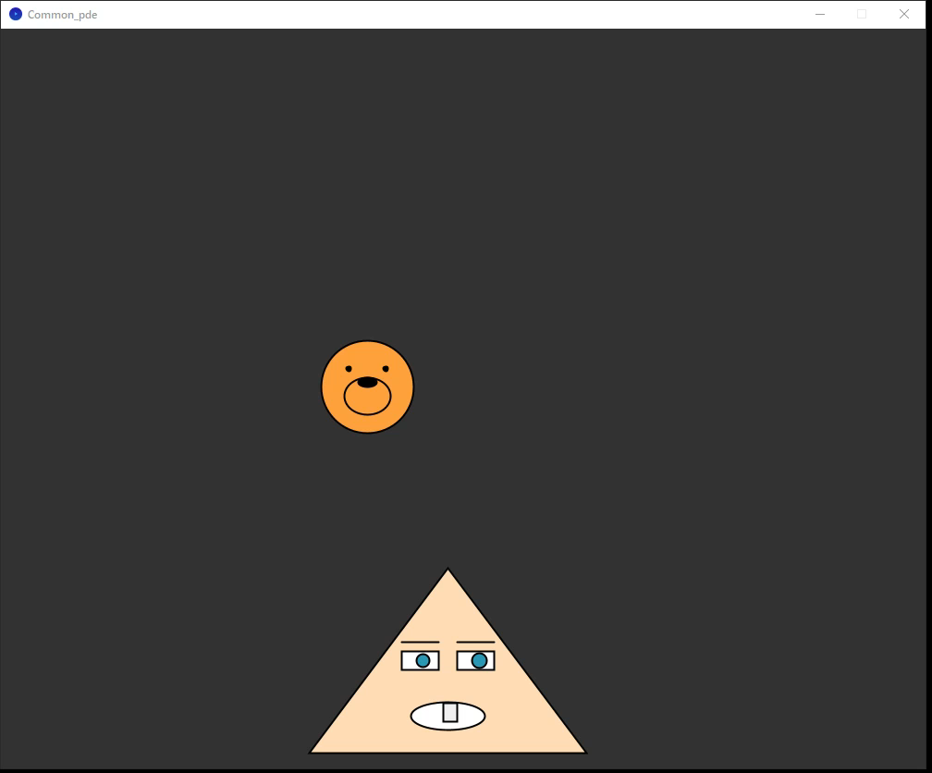

Slide 13
Impressions on completing the assignment
Haneul:
I created an animation of my pet moving and bouncing around the screen.
The task was fun and interesting. It was exciting to watch my pet move on the screen.
Artem:
I animated my triangular character so it could move and bounce.
It was fun to see it work and to compare it with Haneul’s pet.
Extra
We tried adding collision detection between the two characters.
It was not required, but it was interesting to implement.
The collision made the animation look more interactive.

Slide 14
All source code
The full project is uploaded to GitHub: https://github.com/brevno-project/Java

